Slide 1
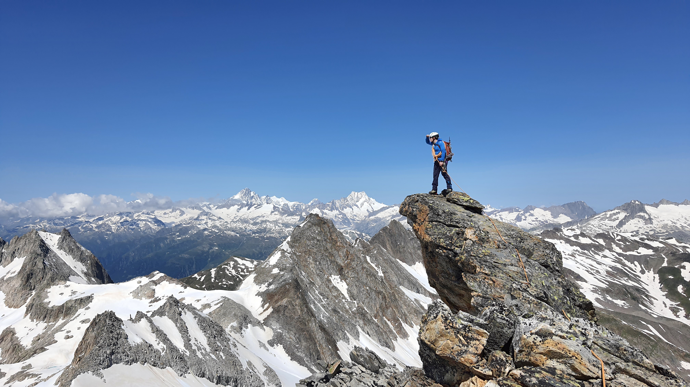
Polyhack 2021, Team 5, Benjamin Ries, Alzbeta Kubincova, Marc Lehner
What are you looking for?

Slide 2
What are you looking for?
An amazing outdoor activity
Stress free to get there
Easy planning

Slide 3
What are you looking for?
Convenience!

Slide 4
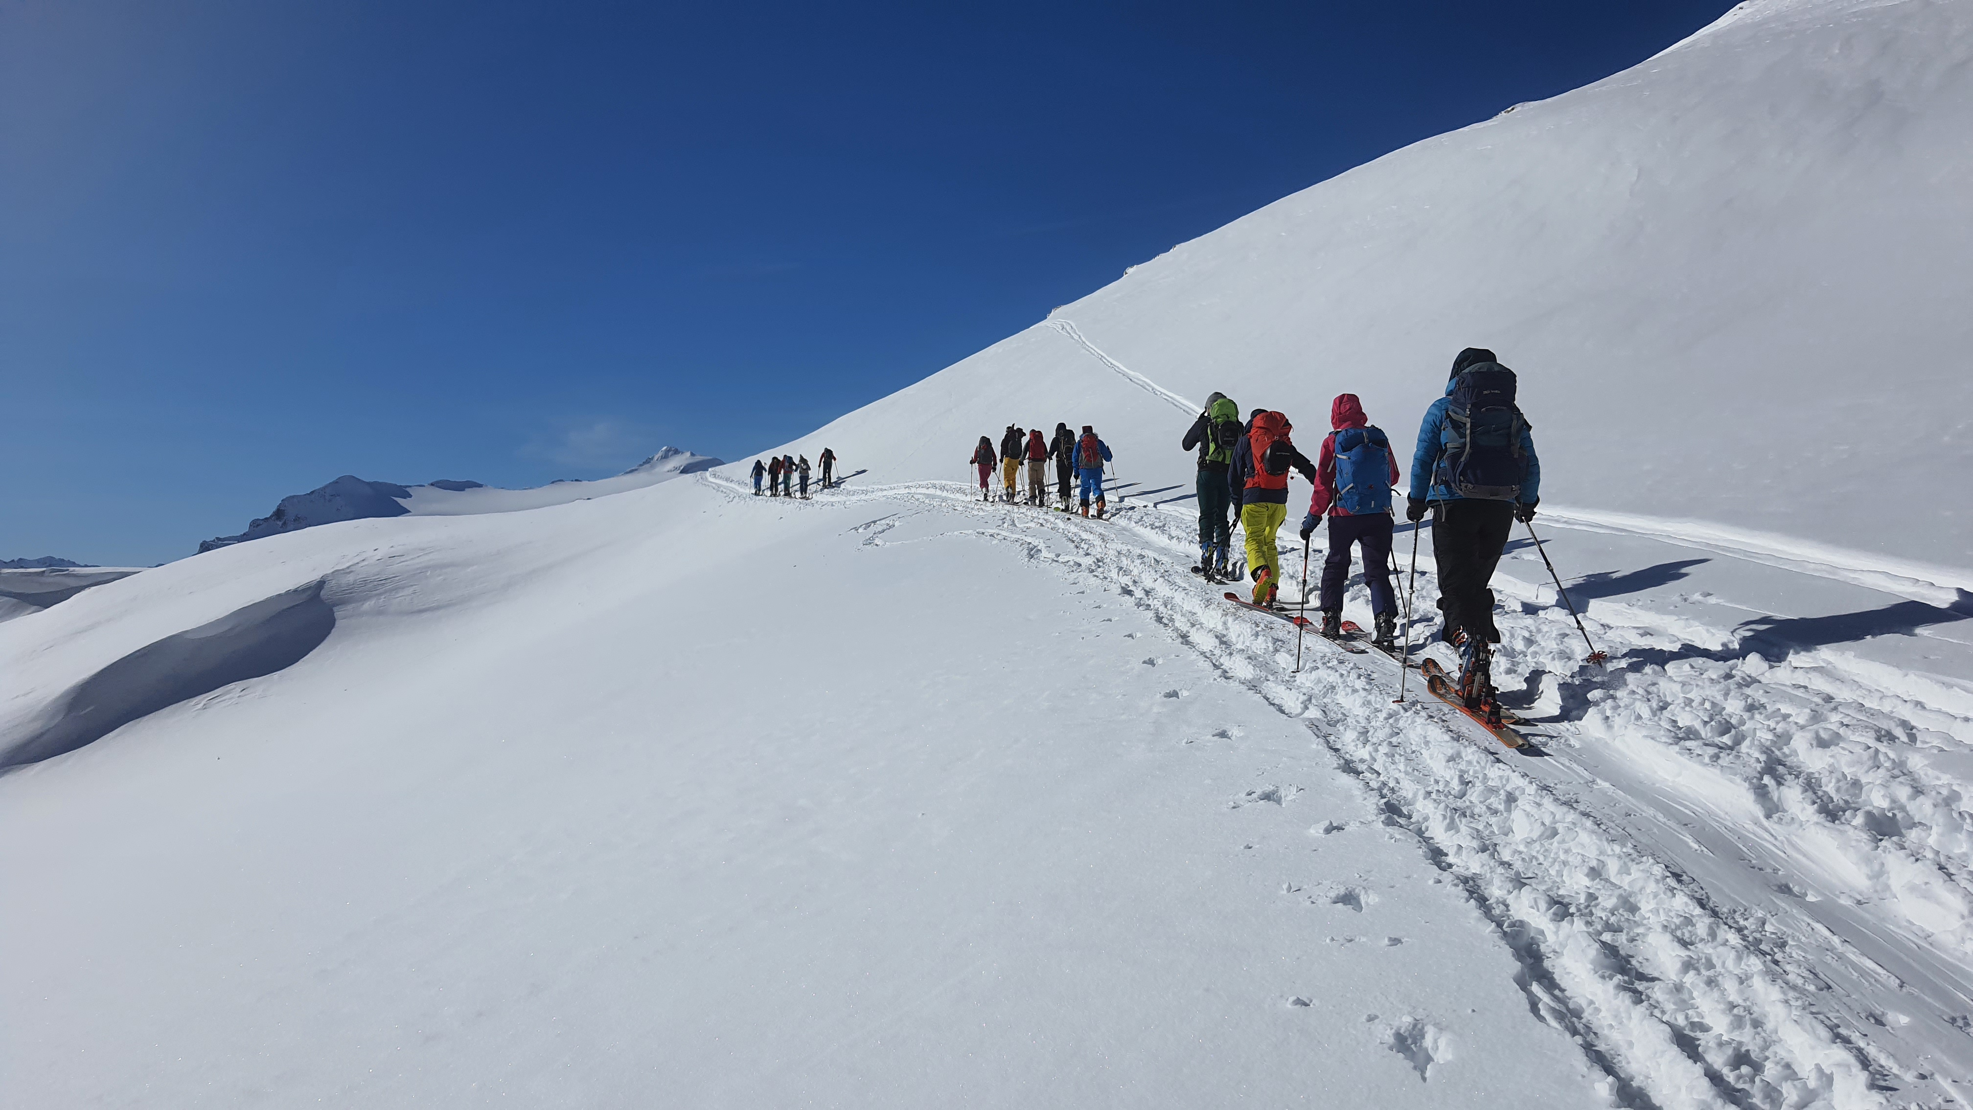
Streamline decision making and
Rank options by convenience
Convenience Rating:
How close to the next station is the start of the trip
How long does the train ride take
How many train/bus changes
Additional factors, specific to your activity and preferences

Slide 5
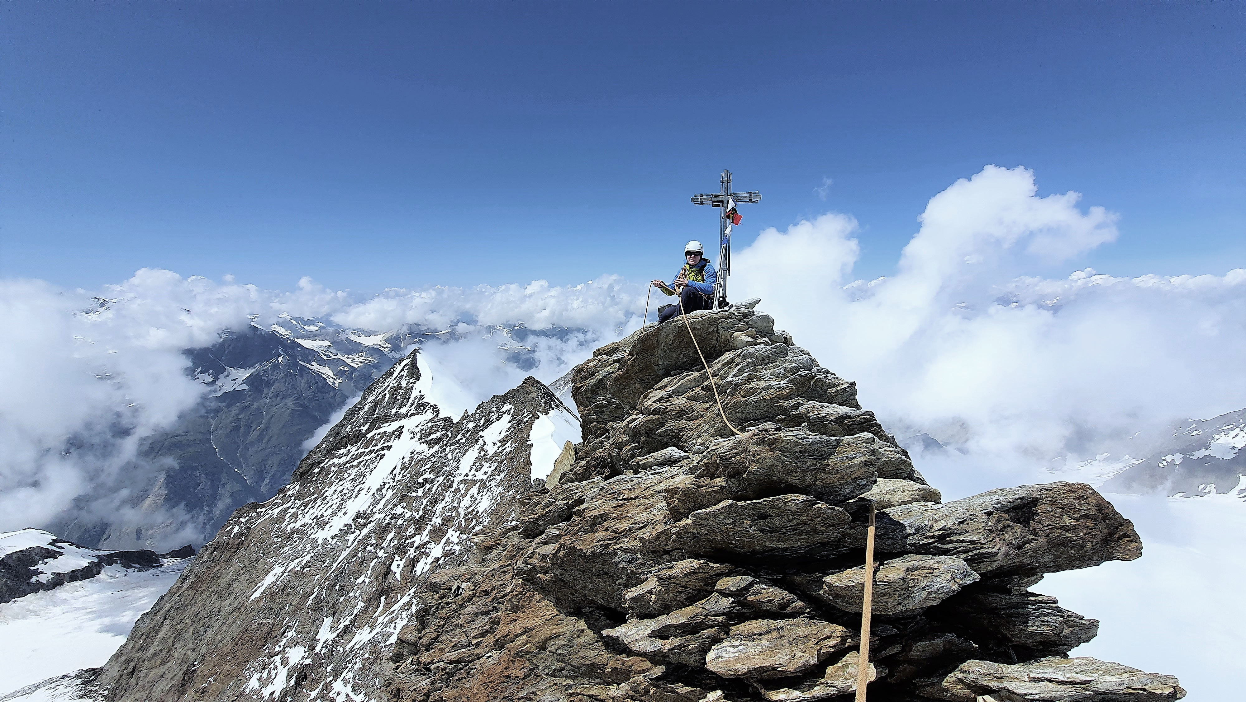
Guide people to smart decisions
Add convenience factor to decision making:
Outdoor activities rated with convenience
Easy to use platform
Random inspiration
More flexibility
Add to SBB app and SBB website

Slide 6
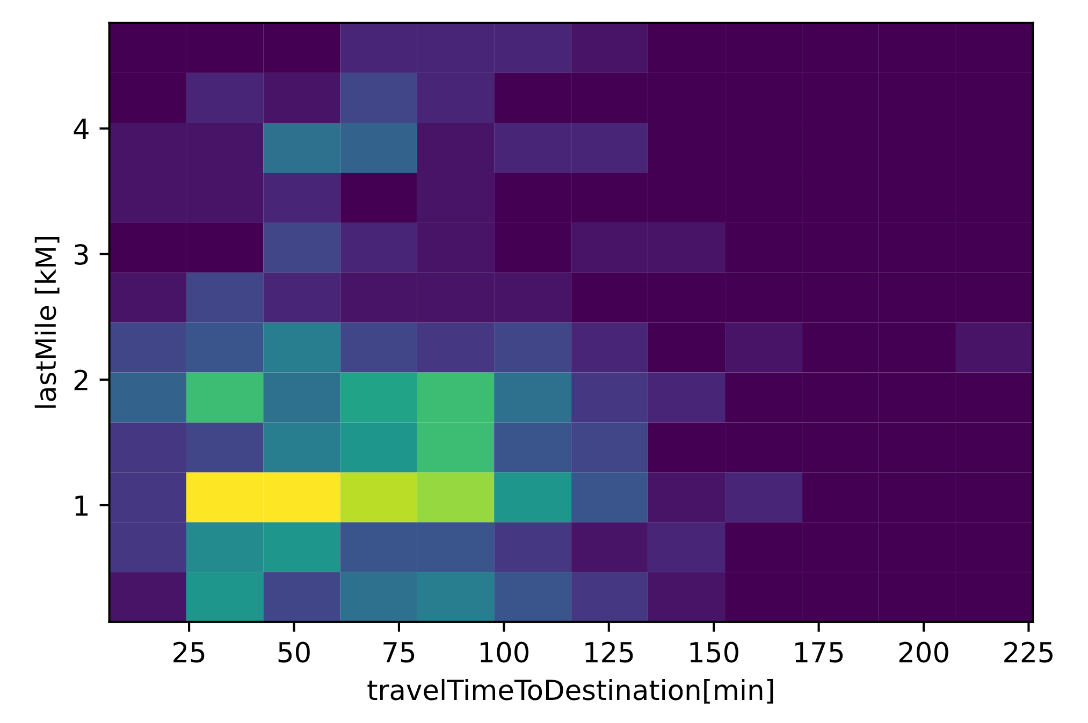
Convenience rating
Data
Outdoor Activity
Weather
SBB
Try to optimize:
Travel time
Last mile
Expectations

Slide 7
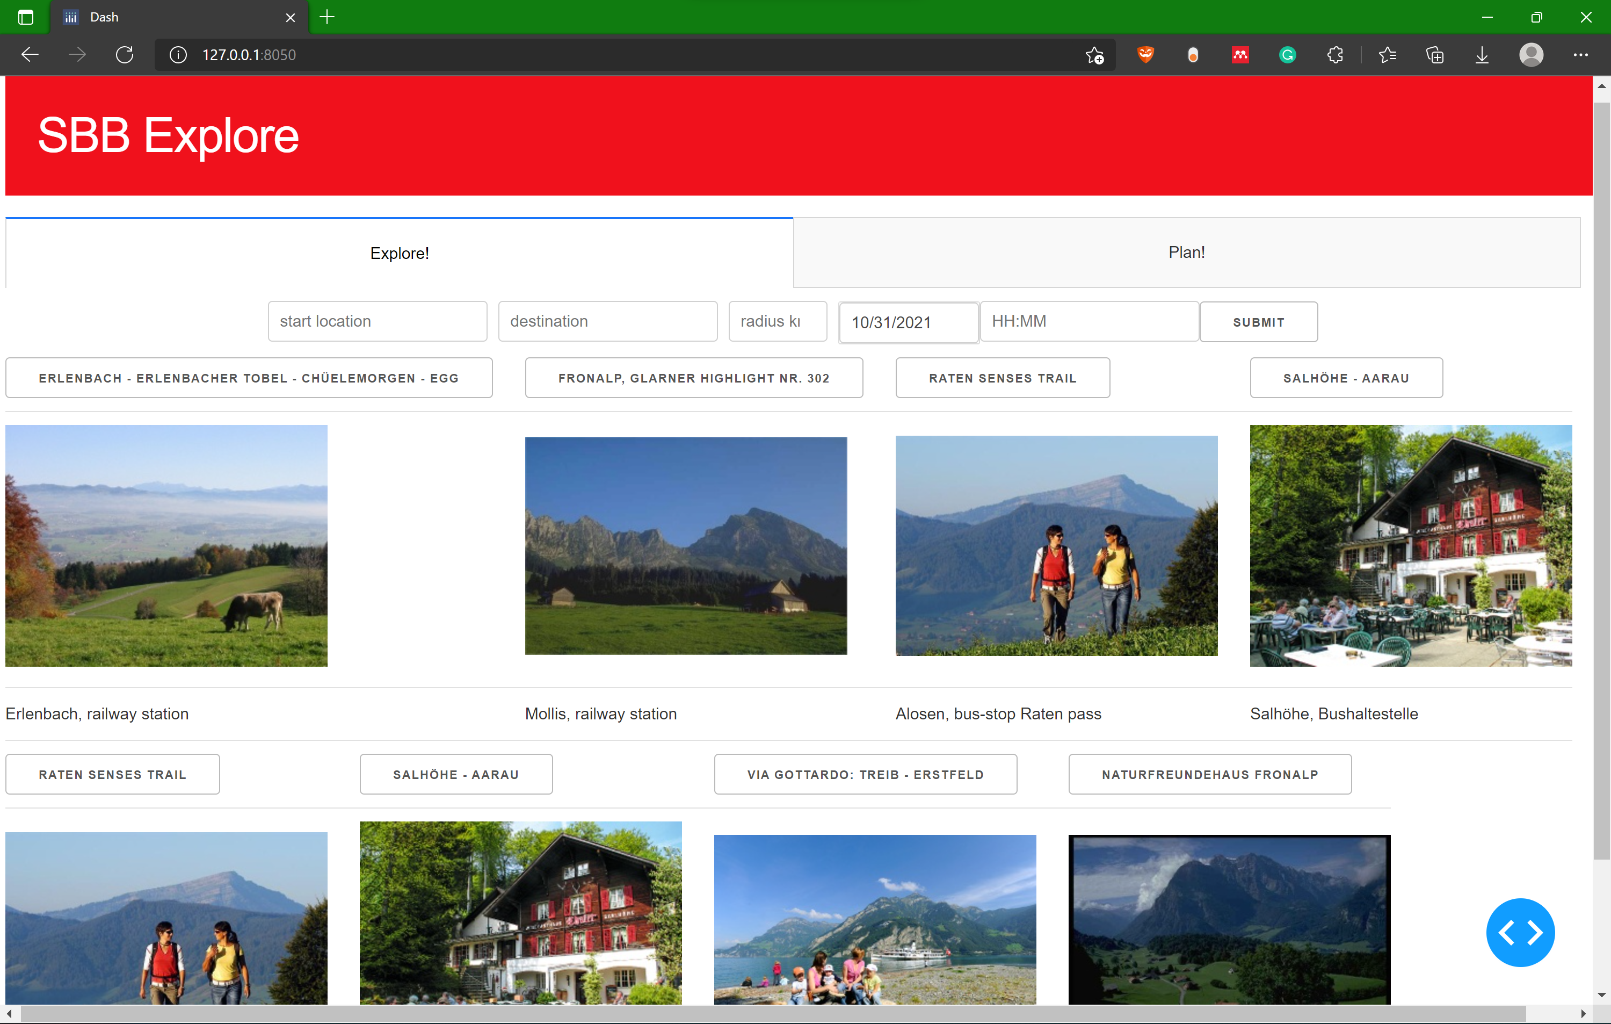
Explore – View from our website
Add you starting location
(add a target region)
Add date and time
Get inspired by convenient outdoor activities

Slide 8
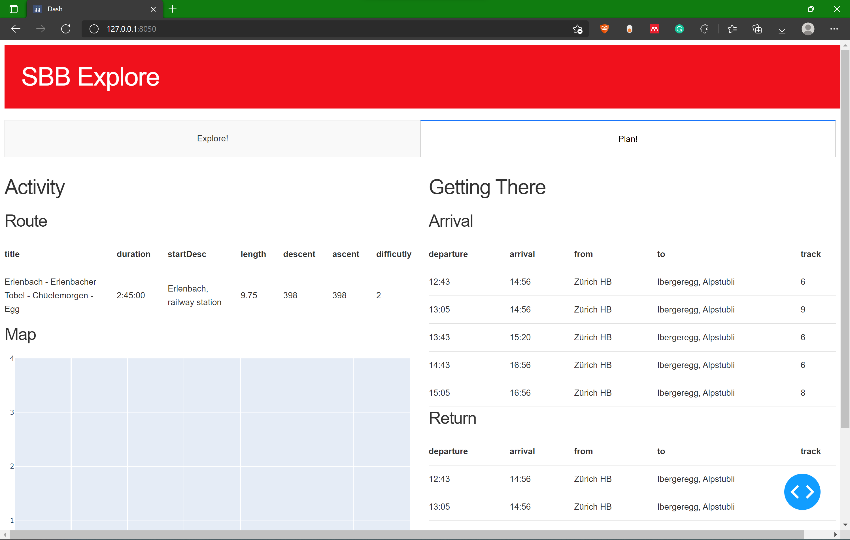
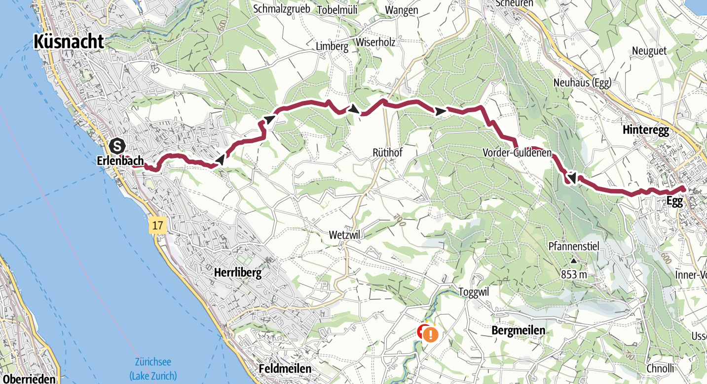
Planning – View from our website
Get quick information about selected trip
See possible SBB connections
TODO: buy ticket

Slide 9
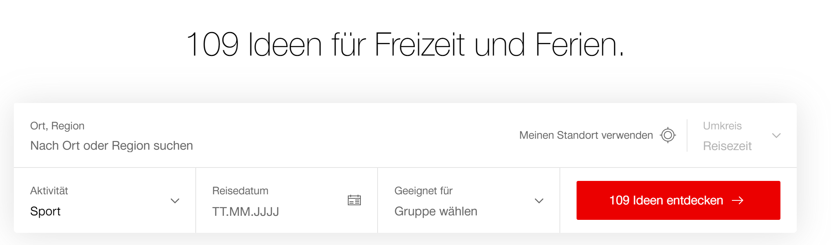





Outlook
Possible collaborations
Outdoor activities
Swiss Parks
Gastronomie Suisse
SAC
Addition to SBB freizeitangebot https://www.sbb.ch/de/freizeit-ferien/freizeitangebote/tagesausfluege.html
Increasing the options from 109 to over 5000 options
Addition to the SBB app
Using current location
Setting preferences

Slide 10

Conclusion
Smart decision making
Convenience
Fully integrable
Code available on GitHub: https://github.com/SchroederB/polyHack2021_SBB

Slide 11
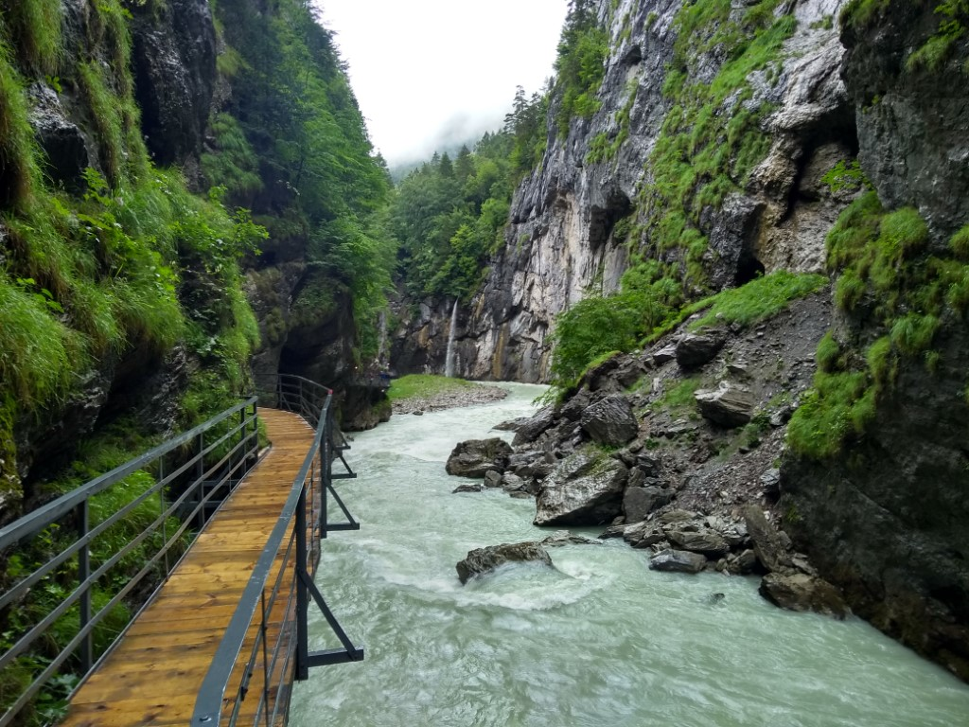
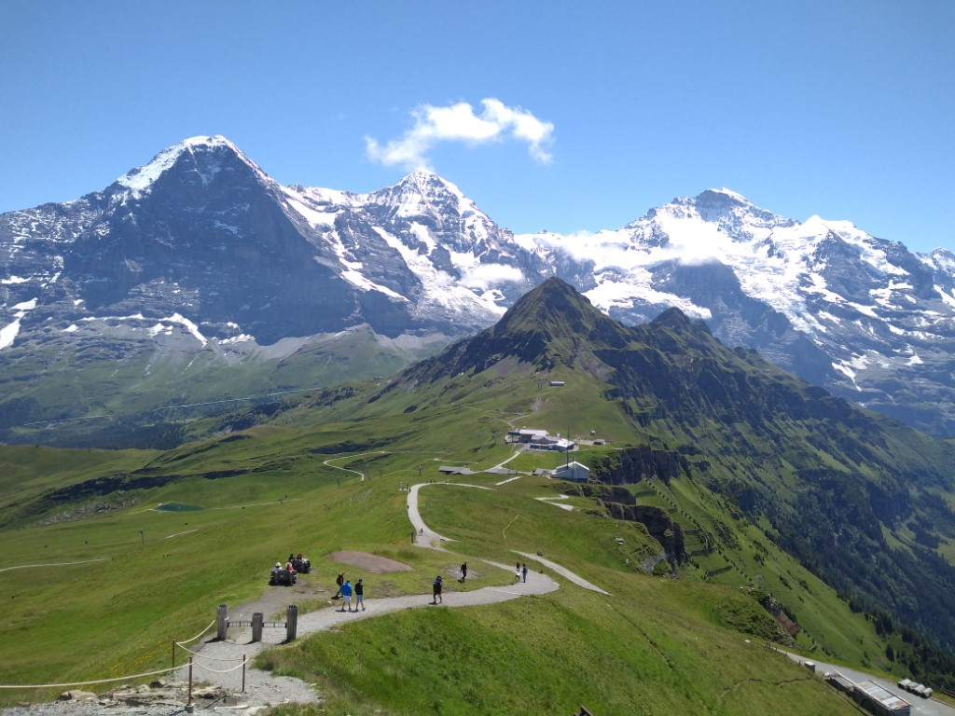
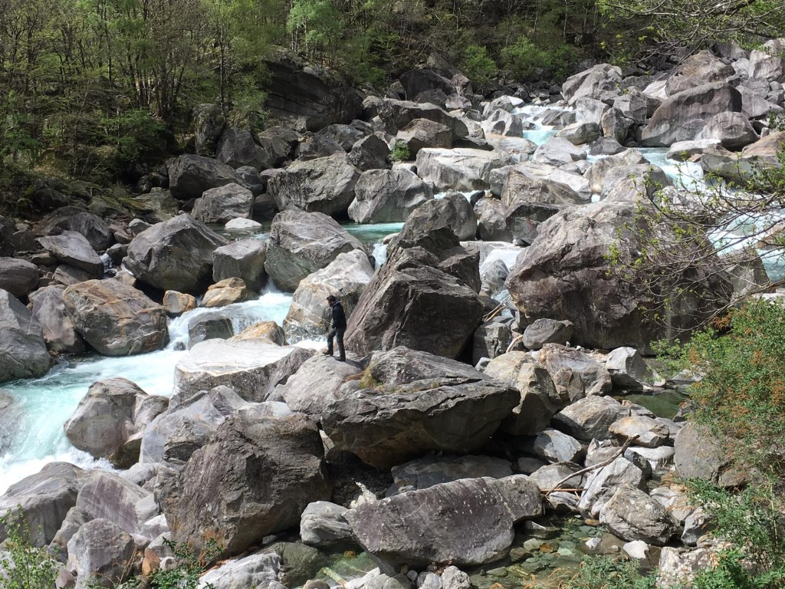
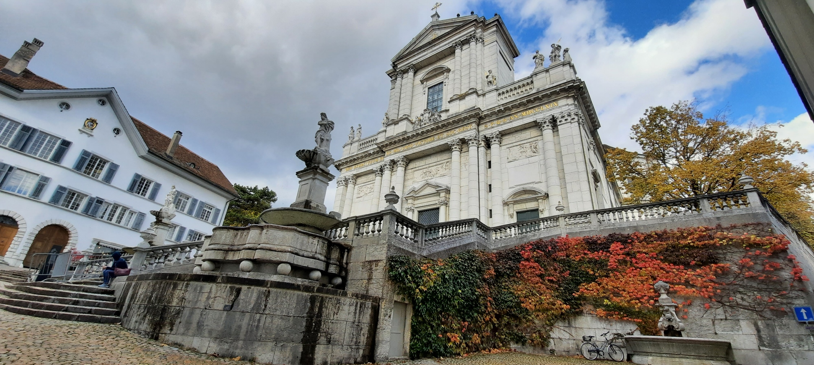

Plan
SBB Mobile
Aare Schlucht - Hike
Active
City

Slide 12
Explore
SBB Mobile
Explore
Active
City

Slide 13
Share
SBB Mobile
Explore
Active
City

Slide 14
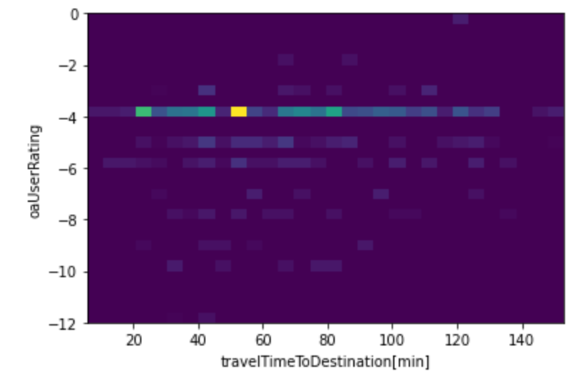

Slide 15
